Slide 1
Assessment for Learning : where are we on the digital assessment spectrum?
Professor Denise Whitelock
The Open University
Denise.whitelock@open.ac.uk

Slide 2
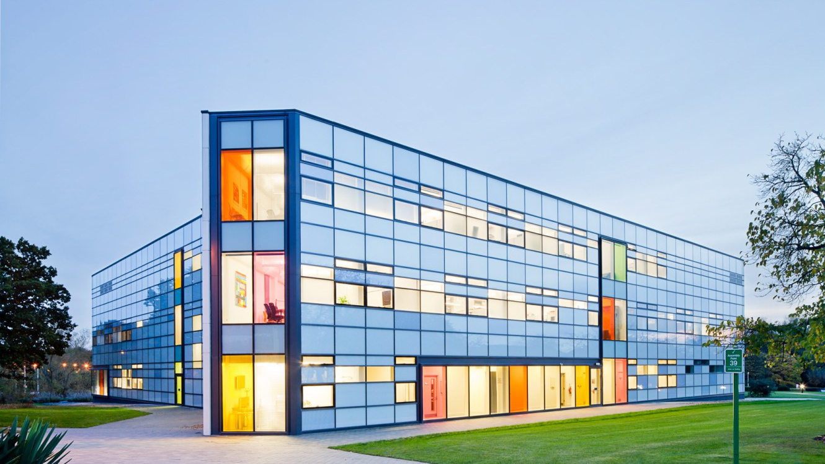

The largest open distance university in Europe
~170,000 students
~24,000 students with SEND
THE OPEN UNIVERSITY (UK)

Slide 3
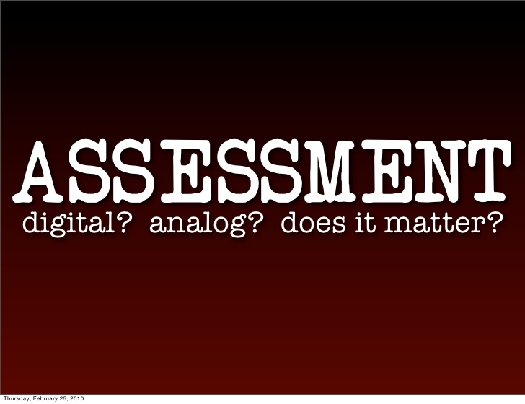
Content
Who is driving digital assessment?
Students
Teachers
Researchers
Awarding Bodies
Software developers
Disrupters
Denise Whitelock, END 2019

Slide 4
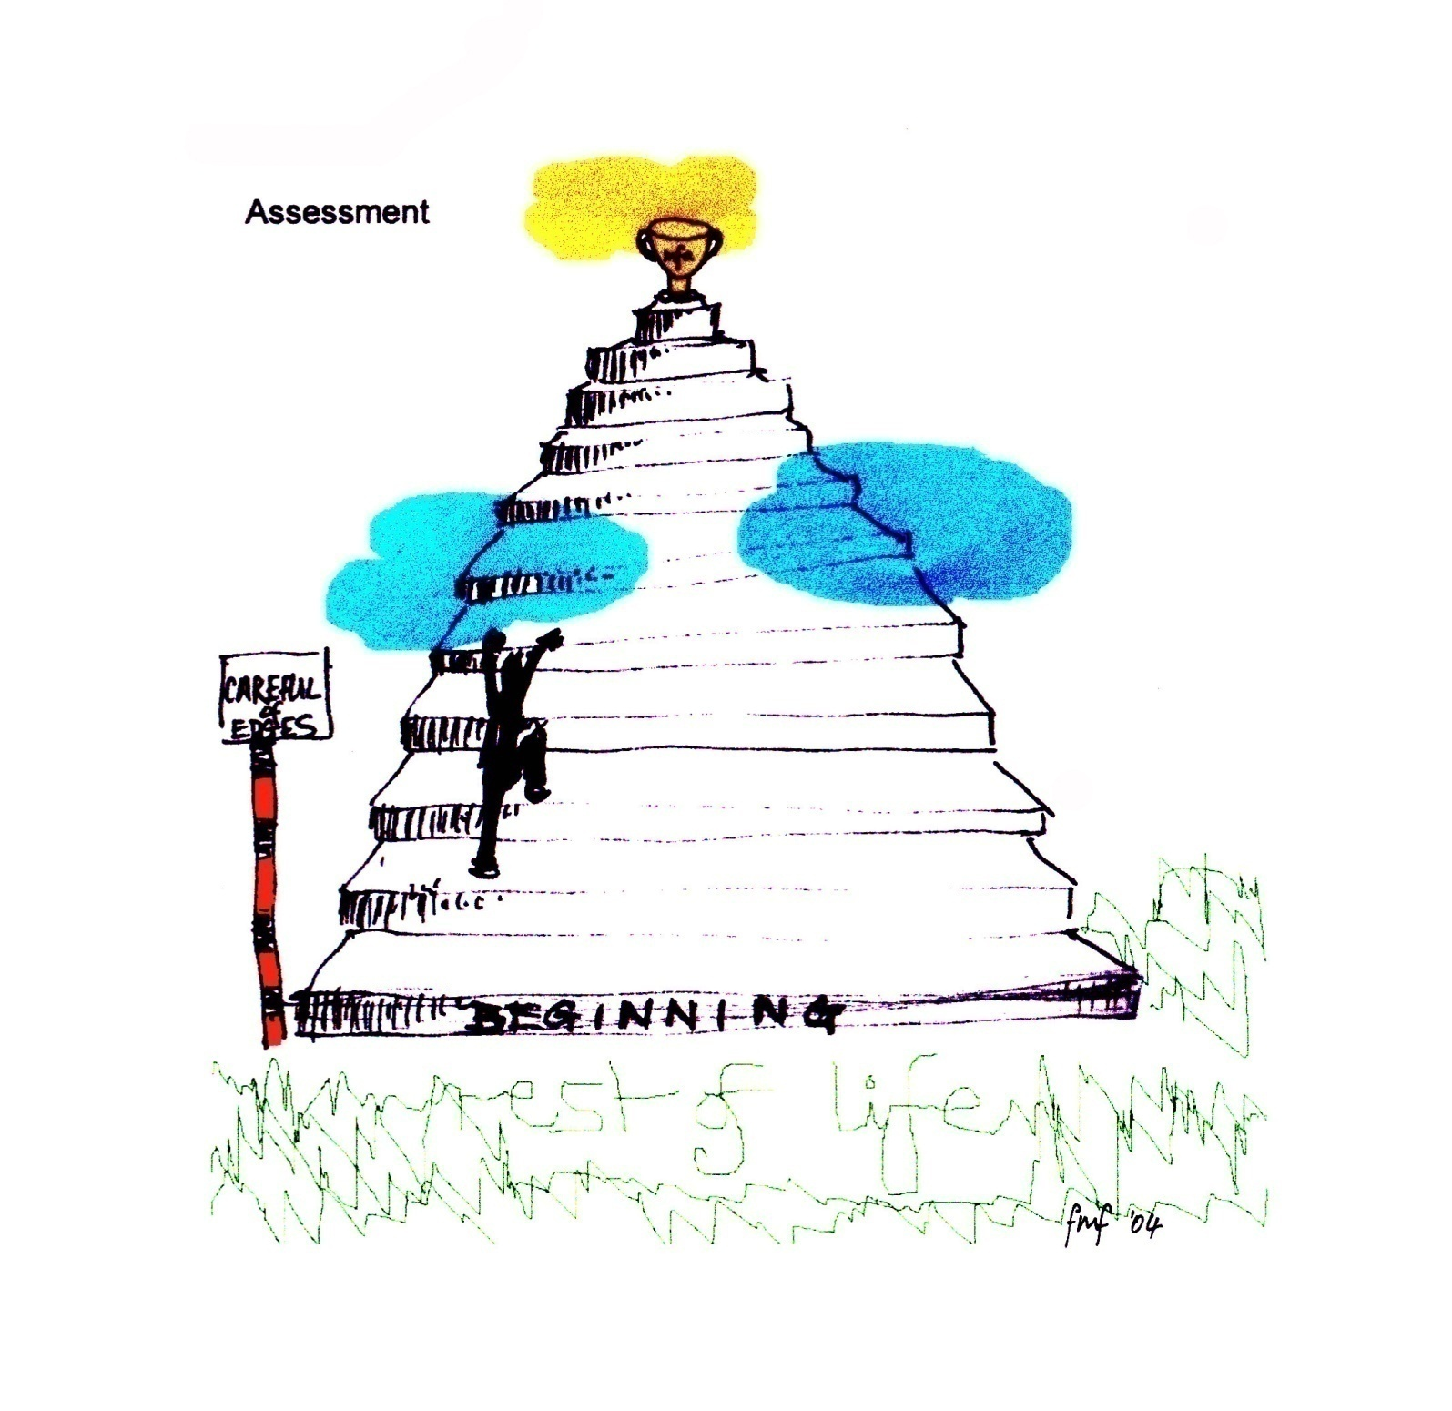
Students
Students’ feelings about Assessment
Denise Whitelock, END 2019

Slide 5
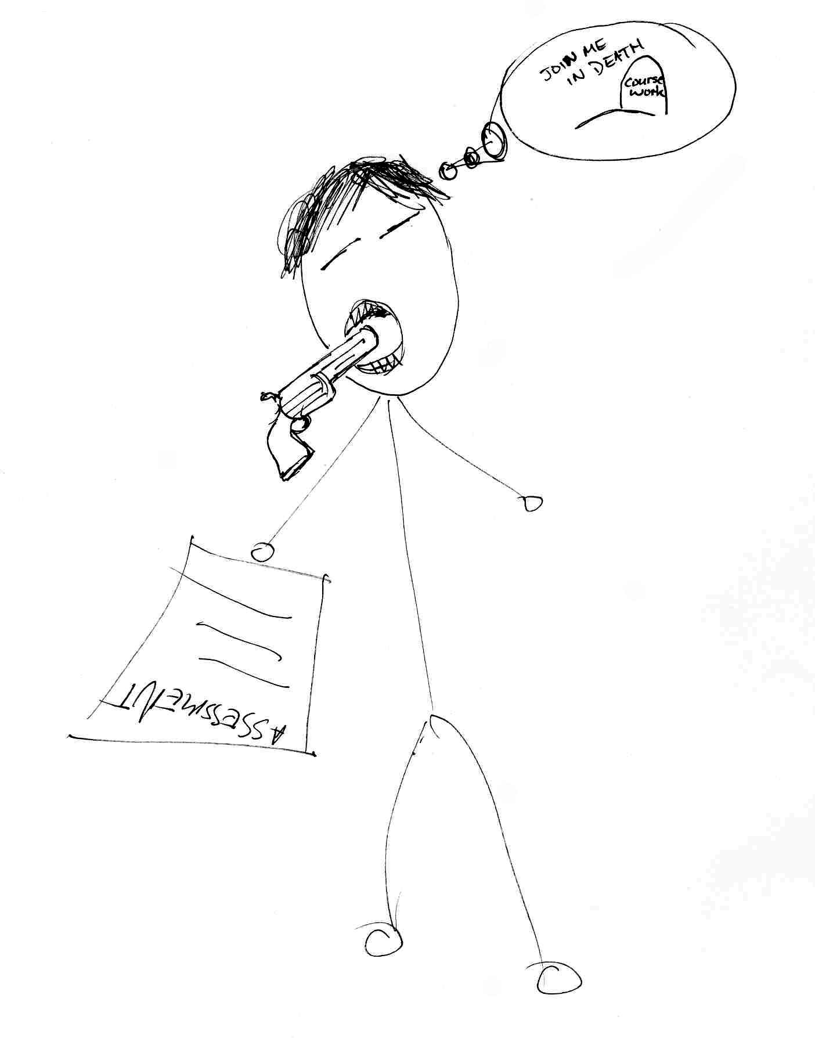
Students
Students’ feelings about Assessment
www.storiesabout.com
www.storiesabout.com/creativepdp
c.mckillop@rgu.ac.uk
Denise Whitelock, END 2019

Slide 6
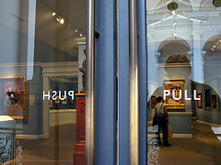
Awarding Bodies
The e-Assessment and automatic feedback Challenge
Constructivist Learning – Push
Institutional reliability and accountability – Pull
Denise Whitelock, END 2019

Slide 7
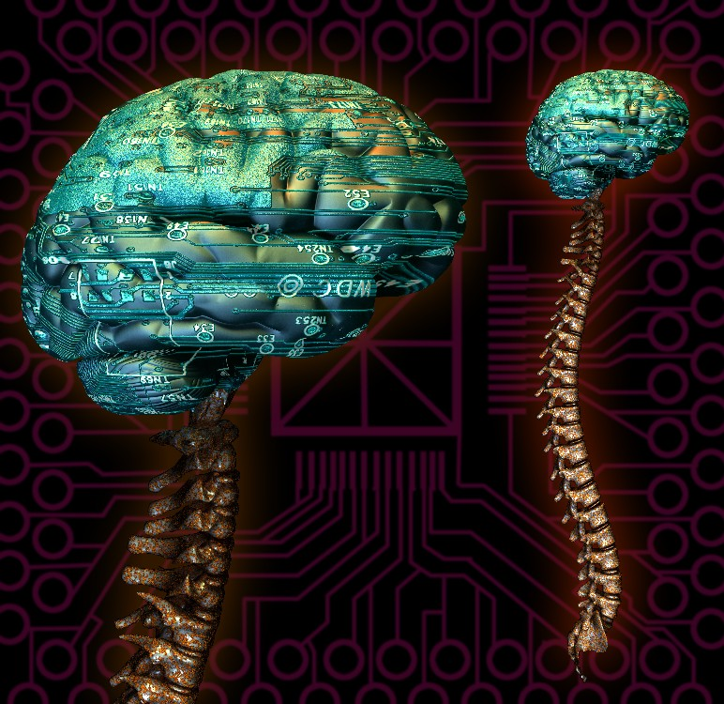
Awarding Bodies
Grand Challenge representing analysis of learning that can be readily understood
Denise Whitelock, END 2019

Slide 8
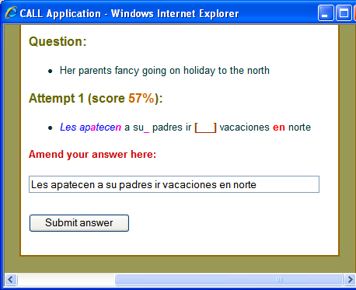
Teachers
The LISC solution: developed by Ali Fowler
A CALL system designed to enable students to:
  Independently practise sentence translation
  Receive immediate (and robust) feedback on all errors
  Attend immediately to the feedback (before fossilisation can occur)
Denise Whitelock, END 2019

Slide 9
Teachers
How is the final mark arrived at in the LISC System?
The two submissions are unequally weighted
  Best to give more weight to the first attempt
    since this ensures that students give careful consideration to the construction of their first answer
    but can improve their mark by refining the answer
  The marks ratio can vary (depending on assessment/feedback type)
    the more information given in the feedback, the lower the weight the second mark should carry
Denise Whitelock, END 2019

Slide 10

Students
Supporting Students Anxiety
Maintain empathy with the Learner
Socio e-emotive content
Advice for Action
Denise Whitelock, END 2019

Slide 11
Researchers
Evidence from literature re Praise feedback for Open Comment
Praise for ability per se can hinder learning (Mueller & Dweck, 1998)
Praise = being clever
Negative feedback now without ability
Disempowering and demoralising
Denise Whitelock, END 2019

Slide 12
Researchers
Mueller & Dweck (1998)
Raven’s Matrices (IQ)
First test pupils praise either for effort or ability
Second test most difficult
Third test medium difficulty. Score up 1 points for pupils praised for effort. Down 1 point ability
Denise Whitelock, END 2019

Slide 13
How does feedback effect mindsets?
Your intelligence is something very basic about you that you can’t change very much
You can learn new things but you can’t really change how intelligent you are
3. No matter how much intelligence you have you can always change it quite a bit
4. You can always substantially change how intelligent you are

Slide 14
Mindsets (Dweck, 2006)
Fixed mindset
Super sensitive about being wrong
Always trying to prove themselves
Growth mindset
Stretch themselves
Confront obstacles as challenges
Lack of tension when learning as they know they are novices and can improve

Slide 15
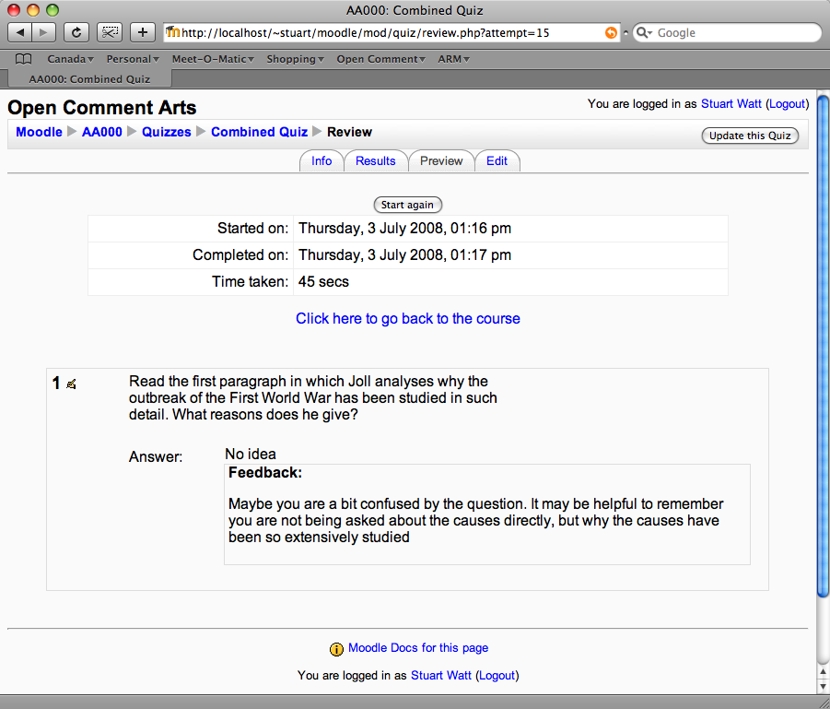

Slide 16
Teachers
Stages of analysis by computer of students’ free text entry for Open Comment: advice with respect to content (socio-emotional support stylised example)
STAGE 1a: DETECT ERRORS E.g. Incorrect dates, facts. (Incorrect inferences and causality is dealt with below)
Instead of concentrating on X, think about Y in order to answer this question Recognise effort (Dweck) and encourage to have another go
You have done well to start answering this question but perhaps you misunderstood it. Instead of thinking about X which did not…….. Consider Y
Denise Whitelock, END 2019

Slide 17
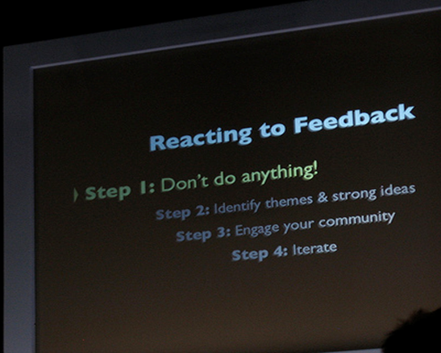
Teachers
Computer analysis continued
STAGE 2a: REVEAL FIRST OMISSION
Consider the role of Z in your answer Praise what is correct and point out what is missing Good but now consider the role X plays in your answer
STAGE 2b: REVEAL SECOND OMISSION
Consider the role of P in your answer Praise what is correct and point out what is missing Yes but also consider P. Would it have produced the same result if P is neglected?
Denise Whitelock, END 2019

Slide 18
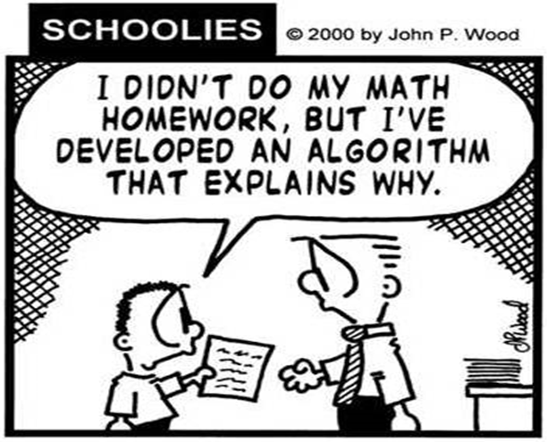
Teachers
Final stages of analysis
STAGE 3:REQUEST CLARIFICATION OF KEY POINT 1
STAGE 4:REQUEST FURTHER ANALYSIS OF KEY POINT 1(Stages 3 and 4 repeated with all the key points)
STAGE 5:REQUEST THE INFERENCE FROM THE ANALYSIS OF KEY POINT 1 IF IT IS MISSING
STAGE 6:REQUEST THE INFERENCE FROM THE ANALYSIS OF KEY POINT 1 IF IT IS NOT COMPLETE
STAGE 7:CHECK THE CAUSALITY
STAGE 8:REQUEST ALL THE CAUSAL FACTORS ARE WEIGHTED
Denise Whitelock, END 2019

Slide 19
Teachers
What about emotional support in the feedback?
Difficult at times to receive written feedback
Not just a cognitive response
How can Bales help?
Denise Whitelock, END 2019

Slide 20
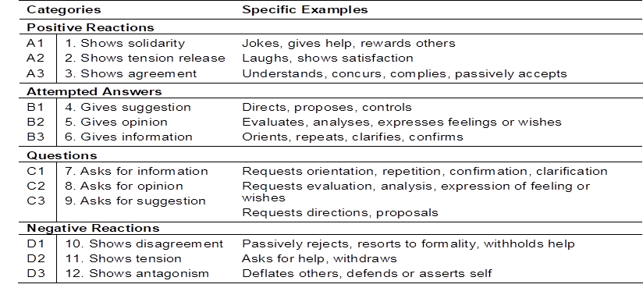
Teachers
Coding the tutor comments
Bales’ Interaction Process
Denise Whitelock, END 2019

Slide 21
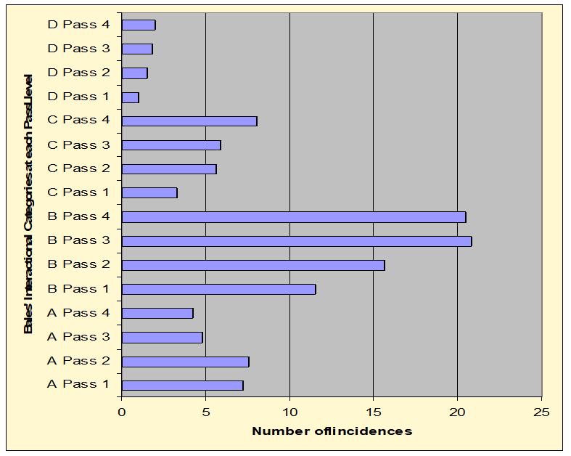
Teachers
Identifying trends: H801
Graph to show conflated Bale’s categories against mean number of incidences in H801 scripts
Denise Whitelock, END 2019

Slide 22
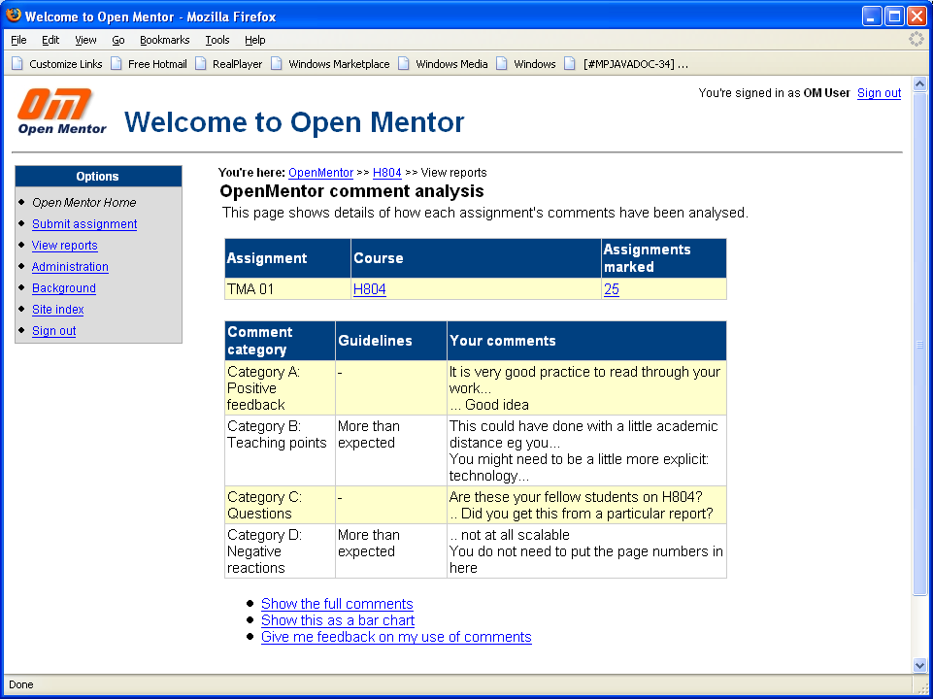

Slide 23
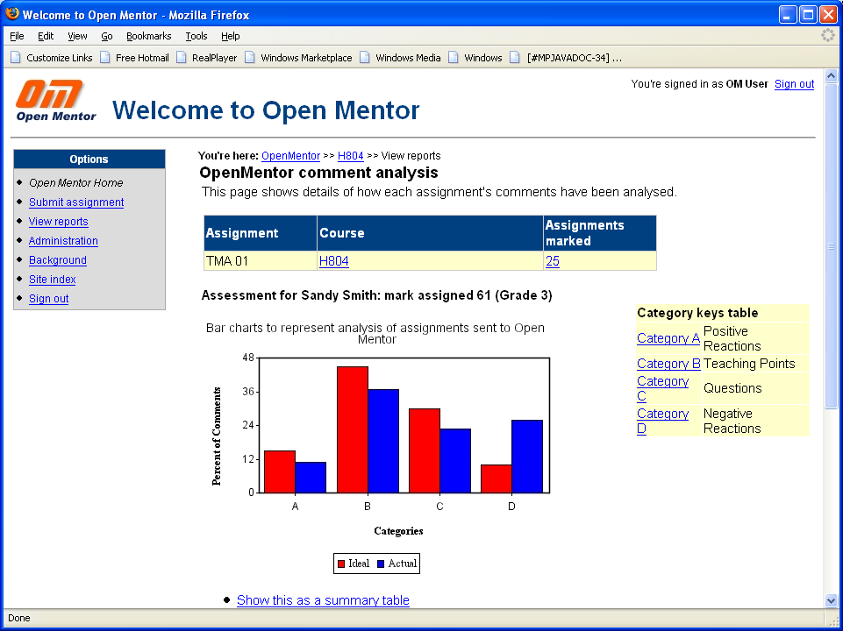

Slide 24
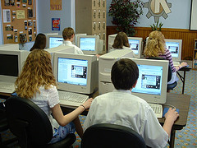



SAFeSEA: Supportive Automated Feedback for
Short Essay Answers
An automated tool supporting
online writing and assessment
of essays providing
accurate targeted feedback
SAFeSEA
Professor Denise Whitelock
Professor John Richardson
Professor Stephen Pulman
Notes:
24
TODO: finding the right LOGO for Primma

Slide 25

Researchers
About SAFeSEA
No tutor support for drafts of first assignment
Reduce dropout rate with automatic feedback?
Effect of summaristion
What are the beneficial factors?
Correlate measures of learner activity and essay improvement
http://www.open.ac.uk/iet/main/research-innovation/research-projects/supportive-automated-feedback-short-essay-answers
Denise Whitelock, END 2019

Slide 26
Researchers
OpenEssayist: What it tells you
The system’s focus is to present summaries of students’ own work in different ways, to encourage them to reflect constructively on what they have written.
In other words Open Essayist tells them from its analysis what are the most important or key points in their essay. They can then think about whether that was what they intended to emphasise in their essay. If not then they can make the appropriate changes.
A very important aspect of the OpenEssayist system is that it will not tell students what to write, or how to rewrite sections of their essay, or even what is correct or incorrect in their essay.
Denise Whitelock, END May 2019

Slide 27
Researchers
OpenEssayist: How it gives Feedback
Three aspects of the students’ essays are analysed by the system:
  the structure of the essay (which paragraphs constitute the introduction, the conclusion, the discussion sections, etc.),
  the key words and key phrases of their essay (which are the most important words and phrases, the ones that are most representative of the essay's overall meaning)
  the key sentences of their essay (which are whole sentences that are most representative of the essay's overall meaning).
Denise Whitelock, END 2019

Slide 28
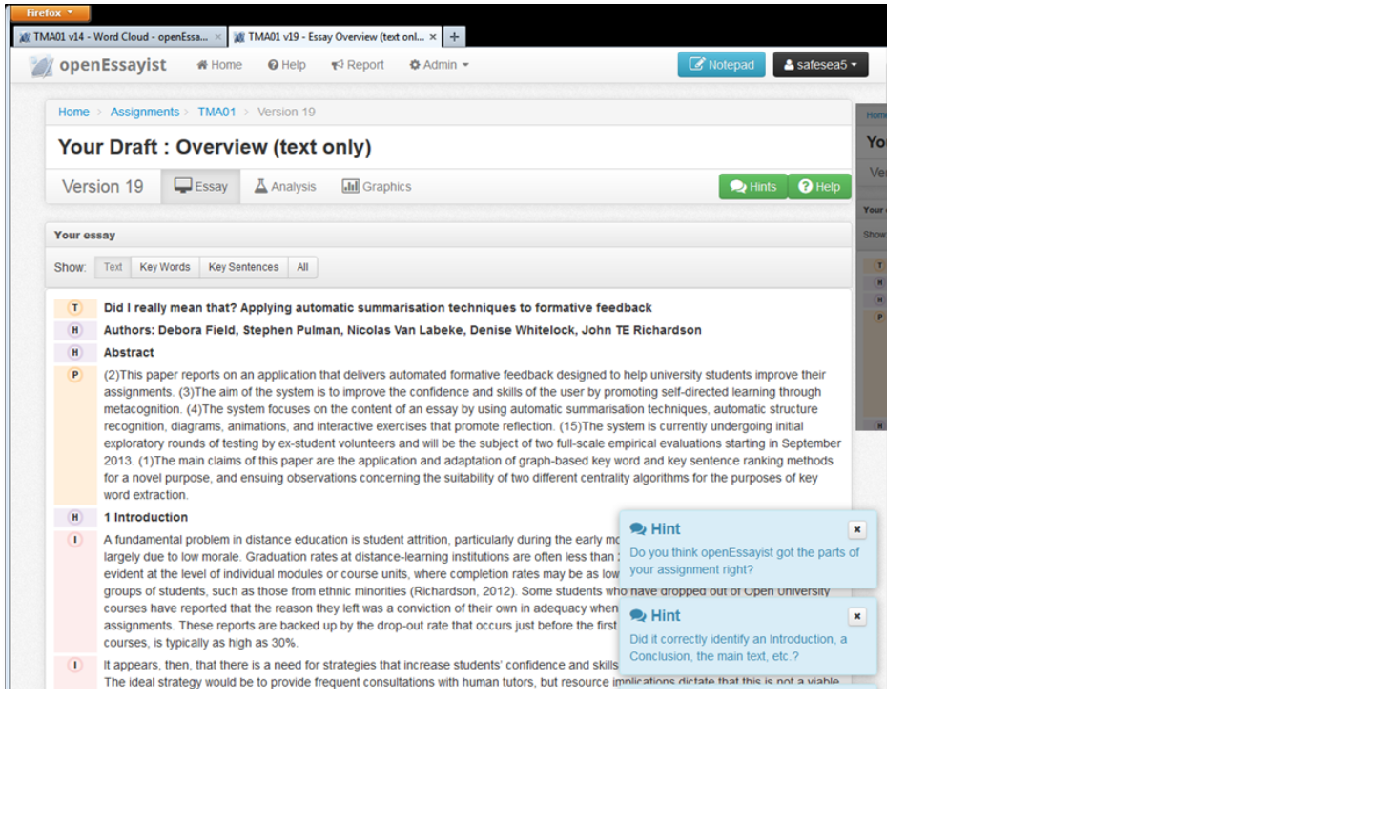

Slide 29
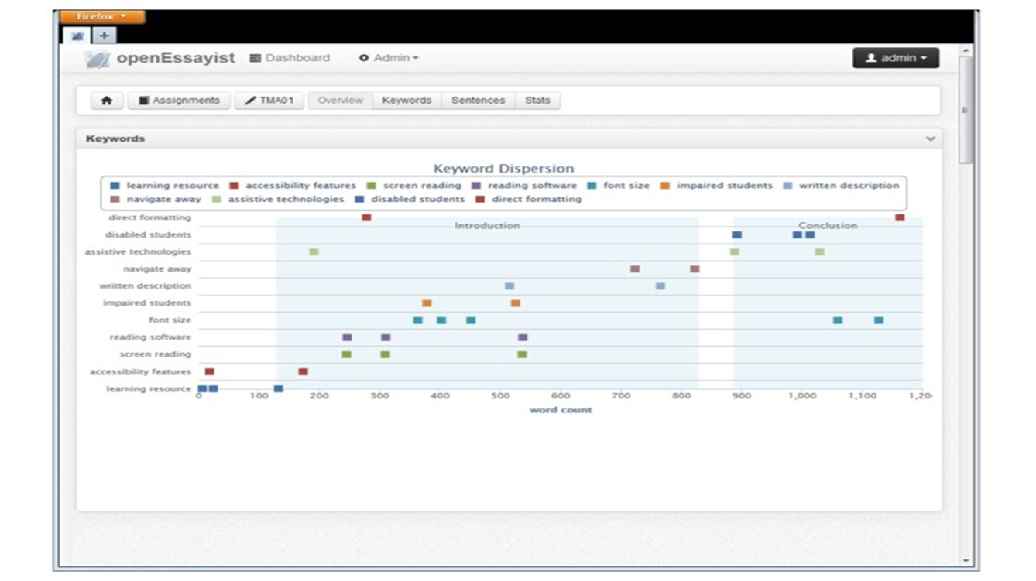
Researchers
Sample key phrases dispersion plot
Denise Whitelock, END 2019

Slide 30
Researchers
Grades and use of OpenEssayist with H817
Used by MAODE students
Positive correlations
Grades for Essay 1 and number of drafts (r=+0.41)
Number of site visits and number of drafts (r=+0.65)
Number of visits and grade for Essay 2 was significant one tailed test (r=+0.5)
Mean grade for overall module for students in cohort who used OpenEssayist (64.2) and students in previous cohort (53.7) (p=0.4)
Denise Whitelock, END 2019

Slide 31
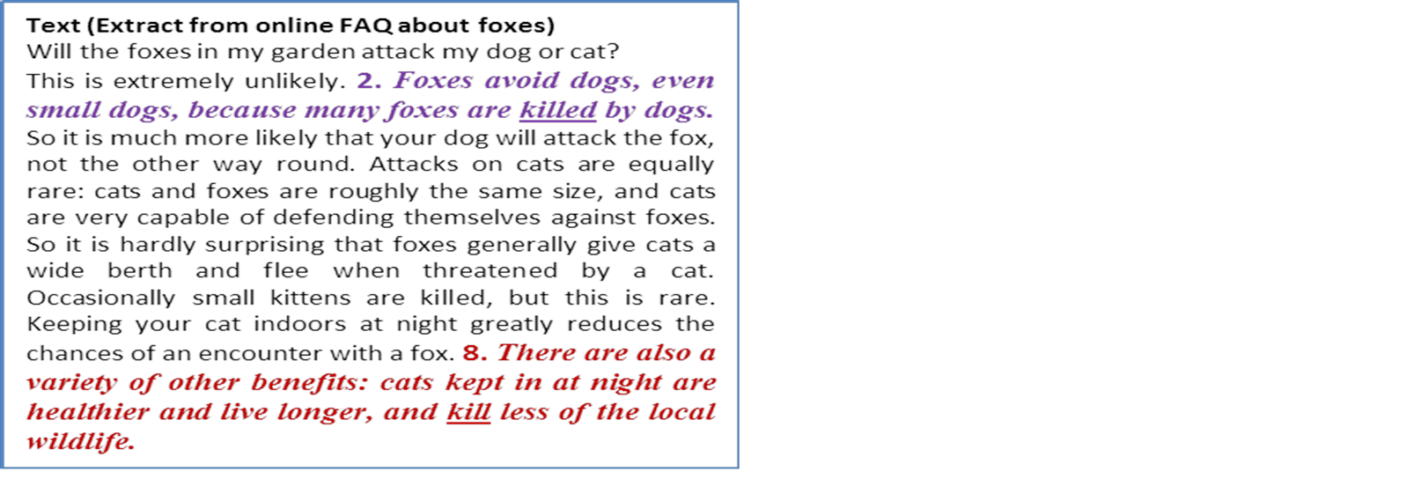
Researchers
Short text for illustration of Rainbow Diagrams
Denise Whitelock, END 2019

Slide 32
Researchers
Sentence graph of short text
Denise Whitelock, END 2019

Slide 33
Researchers
Pretend essay: 10 identical paragraphs
Denise Whitelock, END 2019

Slide 34
Researchers
Pretend essay: 50 identical sentences
Denise Whitelock, END 2019

Slide 35
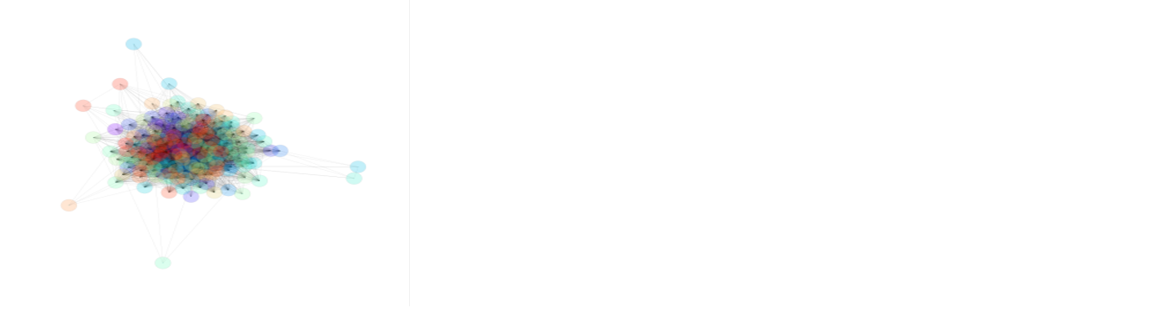
Researchers
Stanford University Boothe Prize essay
Denise Whitelock, END 2019

Slide 36
OU Essay awarded high grade

Slide 37
OU essay awarded low grade

Slide 38
Researchers
Rainbow diagrams related to mark awarded
Multivariate analysis of variance on marks awarded to 45 students
Submitted two essays
Rainbow diagrams produced from these essays and rated as high, medium or low attainment
Covariate showed a significant relationship with the marks
F(1, 43) = 5.92, p = .01 using a directional test
Essays rated as high would be expected to receive 8.56 percentage points more than essays rated as medium
17.2 percentage points higher than essays rated from rainbow diagrams as low
Denise Whitelock, END 2019

Slide 39

NLP developments
Paraphrasing with Amplify (Del Giudice)
SWoRD (Computer Supported Peer Review) Litman et al
BEETLE II Tutorial Dialogue System (Dzikovska et al)

Slide 40
Is NLP the bridge between Digital Assessment and Learning Analytics?
Automatic marking
Recognising text
Refining text

Slide 41
How about feedback first?
Hints before writing?
R.C.T.
2 essays
F(1,41) = 3.23 p = 0.04 for hints

Slide 42

Creating teaching and learning dialogues: towards guided learning supported by technology
Learning to judge
Providing reassurance
Providing a variety of signposted routes to achieve learning goals
Provide socio-emotive support

Slide 43

“Advice for Action”, Whitelock (2011)
Helping students find out what they do not know and how to remedy the situation can avoid the trauma of assessment
Digital Assessment, LA, NLP does the community matter?
More importantly are we on the way to supporting student learning?

Slide 44

Software Developers
How about anywhere anytime testing? TeSLA: Adaptive Trust based e-Assessment
AIM: Secure & reliable online assessment
TECHNOLOGIES: Voice/face recognition, keystoke pattern detection, anti-plagiarism and forensic analysis
18 European partners, OUUK responsible for evaluation
http://tesla-project.eu/
Denise Whitelock, END 2019

Slide 45
TeSLA Participants
STUDENTS | AU | JYU | OUNL | OUUK | SU | TUS | UOC | TOTAL
Total of students to use TeSLA (unique participants) | 2,325 | 1,844 | 417 | 1,617 | 1,457 | 1,574 | 1,868 | 11,102
Students who completed the pre-questionnaire (% of total) | 240 | 167 | 84 | 853 | 232 | 783 | 1169 | 3528
 | 10% | 9% | 20% | 53% | 16% | 50% | 63% | 32%
Students who completed the post-questionnaire (% of total) | 171 | 115 | 57 | 574 | 226 | 452 | 627 | 2222
 | 7% | 6% | 14% | 35% | 16% | 29% | 34% | 20%
Denise Whitelock, END 2019

Slide 46

Participants: subject studied
PILOT 2
Figure 1: Field of study

Slide 47
Participants: language of study
Figure 3: Language of the courses – pilot 3
Notes:
Here is the students view of the system.
Тук се разглеждат стъпките, които студентите преминават, за да работят успешно със системата. Само се изброяват (изчитат се текстовете), за да стане ясно защо именно в този ред се разглеждат функционалностите на следващите слайдове.

Slide 48
Assesment: Summary
Query | Response | % of student-activities
How was the assessment used? | Diagnostic | 1%
 | Formative | 22%
 | Formative & summative | 58%
 | Summative | 11%
 | N/A | 8%
Was the assessment supervised? | Supervised | 12%
 | Unsupervised | 88%
Was the assessment individual or collaborative? | Collaborative | 2%
 | Individual | 94%
 | Individual & collaborative | 4%
What was the type of response required in the assessment activity? | Select answer | 17%
 | Create answer or product | 73%
 | Perform/enact/demonstrate | 11%
What was the response format for response type ‘Create answer or product’? | Audio | 11%
 | Video | 12%
 | Text (natural language or code) | 76%
 | Artefact (e.g. a painting, a meal, sheet music) | 1%
We collected data on 532 activities (274 in pilot 3A and 258 in pilot 3B) in 310 courses (144 in pilot 3A and 166 in pilot 3B).
Notes:
Here is the students view of the system.
Тук се разглеждат стъпките, които студентите преминават, за да работят успешно със системата. Само се изброяват (изчитат се текстовете), за да стане ясно защо именно в този ред се разглеждат функционалностите на следващите слайдове.

Slide 49

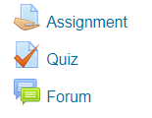
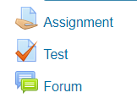

ACTIVITIES WHERE TеSLA IS INTEGRATED
Assignment Submission
Quiz
Course Work
Quizzes with Open/Close Questions
Online Quizzes (conducted in University)
Presentations
Video/Audio Files
Academic Essays
Online Quizzes (conducted at Home)
Forum
Discussions
Online Texts Submission
Group Work
Online Essay Writing
Short Answer
Plan
Course Work
Attendance & Activity
Reading and Reviewing Resources
Opening Files
Access to Video Lectures
Notes:
TeSLA instruments are integrated in three Moodle activities – assignment, quiz and forum. These Moodle activities were used for variety of assessment activities from SU teachers. Here are the most frequently used types of assessment activities and the appropriate Moodle instruments for each of them (изброяват се).

Slide 50
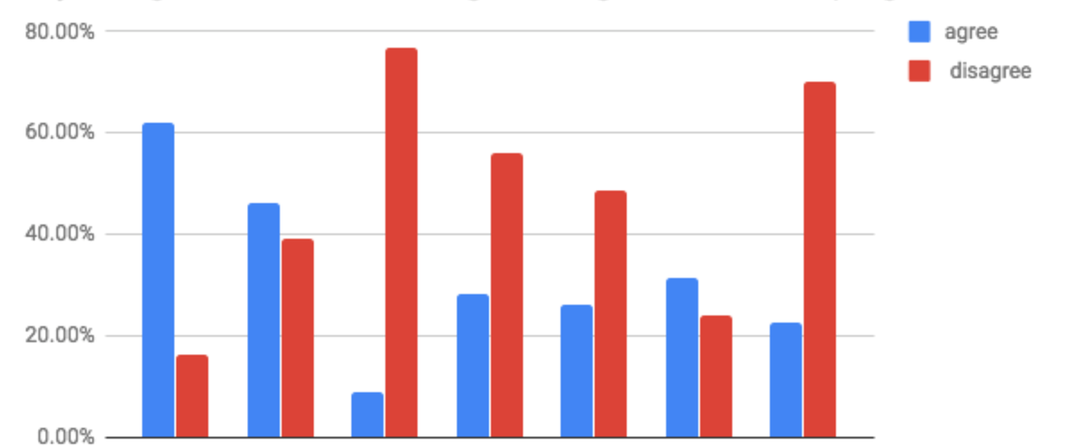
Students’ opinions about plagiarism
“Copying and pasting a paragraph from an academic paper into my assignment and crediting the original source is plagiarism (a type of cheating)”.
Pilot universities
Denise Whitelock, END 2019

Slide 51
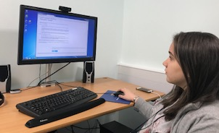
Students from AU (76%) and TUS (78%) are less used to online assessment.
Students views on Trust and possible explanations
There are three universities OUNL (75%) OUUK( 79%) and UOC (82%) whose students trust an on online system, more than those from other institutions.
There are also four universities, AU (24%), JYU (26%), SU (25%) and TUS (21%), where more students do not trust a fully online assessment.
Students from TUS (22%) , SU (15.5%) and AU (7.8%) are less aware of academic malpractices than from OUUK (1.9%) , UOC (4.0%) and OUNL (1.1%).
Most of the students from the test universities identified some advantages to online assessment with authentication, such as; improves rigour and proves submission of original own work.
Only an average of 20% of students are willing to share personal data.
"I find the controversy of e-identity practice controversial. Academic studies on e-identity, identity number, etc. warn us that they can turn us into a surveillance society.” Student from AU
“It is still a very green project, so trust will not be gained overnight”. Student from UOC
Denise Whitelock, END 2019

Slide 52
Outcomes: Students
The most popular TeSLA instruments for students were Forensic Analysis and Anti-Plagiarism: these instruments were less intrusive. And less time was required for their use.
Many felt e-authentication would increase trust in e-assessment for students, institutions and employees.
The most popular reasons given included: e-authentication would make it more difficult for students to cheat.
positive experience for more than 50% of the students
>70% of participating students considered the key advantages of e-assessment with e-authentication to be: “to ensure that my examination results are trusted” and “to prove that my essay is my own original work”.
Notes:
There was not consistency across participants in all institutions as to what constitutes plagiarism

Slide 53
Outcomes: Students
The most popular TeSLA instruments for students were Forensic Analysis and Anti-Plagiarism: these instruments were less intrusive. And less time was required for their use.
Many felt e-authentication would increase trust in e-assessment for students, institutions and employees.
The most popular reasons given included: e-authentication would make it more difficult for students to cheat.
positive experience for more than 50% of the students
>70% of participating students considered the key advantages of e-assessment with e-authentication to be: “to ensure that my examination results are trusted” and “to prove that my essay is my own original work”.
Notes:
There was not consistency across participants in all institutions as to what constitutes plagiarism

Slide 54

Disrupters
Drivers for disruption
Commercial companies
Private online learning institutions
Government policies for shorter, cheaper courses
Denise Whitelock, END 2019

Slide 55
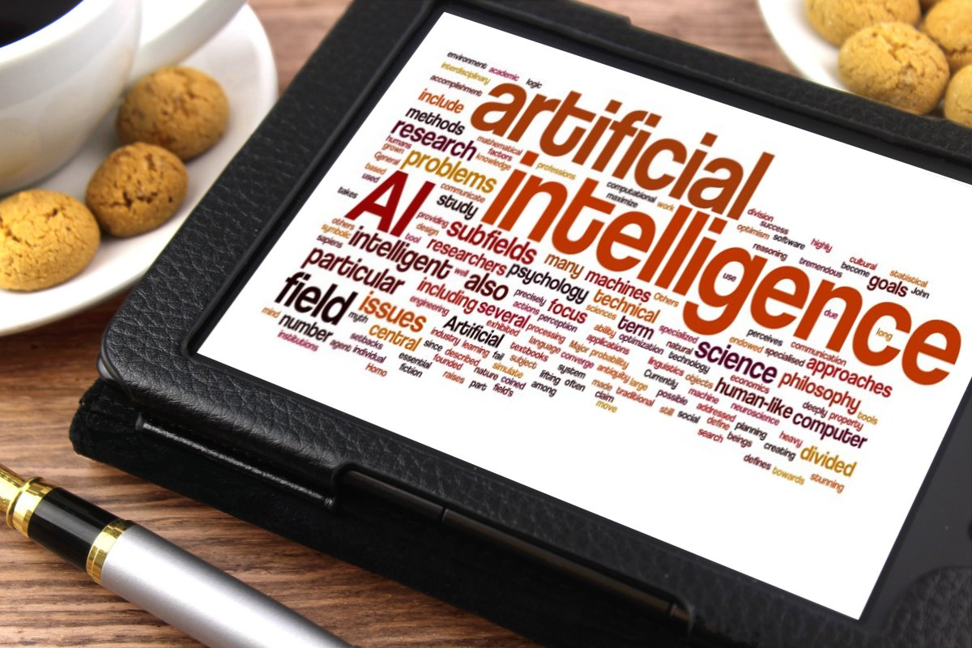
Disrupters
Artificial Intelligence for business
Microsoft Azure
Dixons’ Cami – opening a dialogue for car sales
Carnival Maritime tracks and predicts water use to keep a cruise ship in working order
Denise Whitelock, END 2019

Slide 56
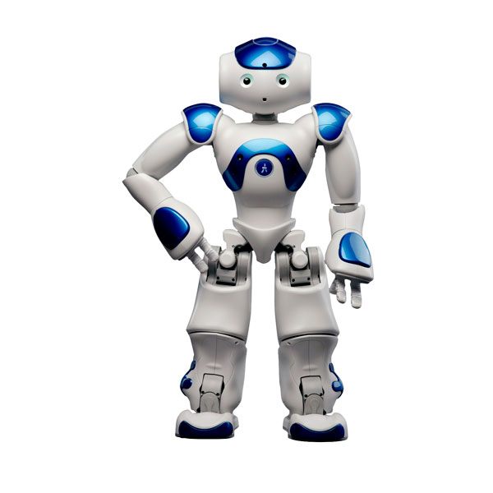
Disrupters
AI for Education
Chatbox recommender systems
Assessment feedback from your own personal robot
Denise Whitelock, END 2019

Slide 57
OH JOY
Denise Whitelock, END 2019

Slide 58
TeSLA Publications: to date,
Edwards, C.; Whitelock, D.; Okada, A. and Holmes, W. (2018). Trust in online authentication tools for online assessment in both formal and informal contexts. In: ICERI2018 Proceedings (Gómez Chova, L.; López Martínez, A. and Candel Torres, I. eds.), 12-14 Nov 2018, Seville, Spain, IATED Academy, pp. 3754–3762.
Okada, Alexandra; Whitelock, Denise and Holmes, Wayne (2017). Students’ views on trust-based e-assessment system for online and blended environments. In: The Online, Open and Flexible Higher Education Conference, 25-27 Oct 2017, Open University, Milton Keynes.
Okada, Alexandra; Whitelock, Denise; Holmes, Wayne and Edwards, Chris (2017).Student acceptance of online assessment with e-authentication in the UK. In: The 2017 International Technology Enhanced Assessment Conference (TEA 2017, 5-6 Oct 2017, Barcelona, Spain.
Okada, Alexandra; Whitelock, Denise; Holmes, Wayne and Edwards, Chris (2019). e-Authentication for online assessment: A mixed-method study. British Journal of Educational Technology, 50(2) pp. 861–875.
Bektik, Duygu; Cross, Simon; Holmes, Wayne; Aleksieva, Lyubka and Whitelock, Denise(2017). A European pilot study of a modular assessment system designed to authenticate the authorship of online learners. In: CALRG Annual Conference 2017, 14-16 Jun 2017, The Open University, Milton Keynes, UK.
Edwards, Chris; Holmes, Wayne; Whitelock, Denise and Okada, Ale (2018). Student Trust in e-Authentication. In: L@S '18: Proceedings of the Fifth Annual ACM Conference on Learning at Scale, ACM, New York, article no. 42.
Edwards, Chris; Whitelock, Denise; Brouns, Francis; Rodríguez, M. Elena; Okada, Alexandra; Baneres, David and Holmes, Wayne (2019). An embedded approach to plagiarism detection using the TeSLA e-authentication system. In: TEA 2018 Technology Enhanced Assessment Conference, 10-11 Dec 2018, Amsterdam, the Netherlands, (In Press).
Notes:
Have free access to TeSLA for 2 years now project has ended.
We passed the final review and the reviewers were pleased with the progress with respect to the software development ready for commercial exploitation

Slide 59
References
Okada, A., Noguera, I., Alexieva, L., Rozeva, A., Kocdar, S., Brouns, F., Ladonlati, T., Whitelock, D., & Guerrero-Roldan, A-E. (In Press). Pedagogical approaches for e-assessment with authentication and authorship verification in Higher Education. British Journal of Educational Technology
Whitelock, D., Twiner, A., Richardson, J.T.E., Field, D. & Pulman, S. (2018). What does a ‘good’ essay look like? Rainbow diagrams representing essay quality. In: E. Ras & A. Guerrero Roldan (Eds.) Technology Enhanced Assessment (TEA2017). Communications in Computer and Information Science, Springer, Cham, 829, 1-12.
Whitelock, D. (2018). Advice for Action with Automatic Feedback Systems. In: S. Caballe & J. Conesa (Eds.): Software Data Engineering for Network ELearning Environments, Springer
Whitelock, D. & Bektik, D. (2018). Progress and Challenges for Automated Scoring and Feedback systems for large-scale assessments. In: J. Voogt, G. Knezek, R. Christensen and K-W Lai (Eds.): International Handbook of Information Technology in Primary and Secondary Education (2nd ed.), Springer. doi:10.1007/978-3-319-53803-7_39-1

Slide 60
References (2)
Okada, A., Whitelock, D., Holmes, W. & Edwards, C. (2018). e-Authentication for online assessment: A mixed-method study. British Journal of Educational Technology. doi:10.1111/bjet.12608
Perrotta, C. & Whitelock, D. (2017). Assessment for Learning. In: E. Duval, M. Sharples and R. Sutherland (Eds.): Technology Enhanced Learning, Springer, pp. 127-135. ISBN 978-3-319-02599-5 DOI. 10.1007/978-3-319-02600-8
Whitelock, D., Twiner, A., Richardson, J.T.E., Field, D. & Pulman, S. (2017). What types of essay feedback influence implementation: Structure Alone or Structure and Content? In: D. Joosten-ten-Brinke and M. Laanpere (Eds.): Technology Enhanced Assessment TEA 2016, CCIS 653, pp.181-196, Springer. DOI: 10.1007/978-3-319-57744-9_16
Whitelock, D. (2016). Foreword to Formative Assessment, Learning Data Analytics and Gamification: In ICT Education. A volume in Intelligent Data-Centric Systems. In S. Caballé & R. Clarisó (Eds.) Academic Press ISBN: 978-0-12-803637-2

Slide 61
References (3)
Field, D., Pulman, S., Van Labeke, N., Whitelock, D. and Richardson, J.T.E. (2013). Did I really mean that? Applying automatic summarisation techniques to formative feedback. Proceedings of the 9th International Conference Recent Advances in Natural Language Processing (Hissar, Bulgaria, Sep. 2013).
Whitelock, D., Gilbert, L. & Gale, V. (2011) ‘Technology-Enhanced Assessment and Feedback: How is evidence-based literature informing practice?’ International Computer Assisted Assessment Conference, DeVere Grand Harbour Hotel, Southampton, 5/6 July 2011. http://caaconference.co.uk/wp-content/uploads/WhitelockB-CAA2011.pdf
Whitelock, D. (2011) Activating Assessment for Learning: are we on the way with Web 2.0? In M.J.W. Lee & C. McLoughlin (Eds.) IGI Global. pp. 319–342.
Whitelock, D. & Watt, S. (2008) ‘Putting Pedagogy in the driving seat with Open Comment: an open source formative assessment feedback and guidance tool for History Students.’ CAA Conference 2008, Loughborough University, 8/9 July 2008, edited by Farzana Khandia pp. 347-356 ISBN 0-9539572-7-6 http://kn.open.ac.uk/public/document.cfm?docid=11638
Denise Whitelock, END May 2019

